Slide 1
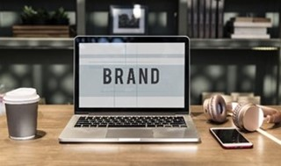
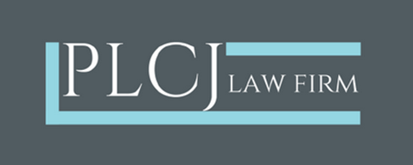
SDGs and IPRs: the relevance of trademarks?
By Ornella BISQUAY
Avocate, Barreau de Paris
Foreign Lawyer
Mauritius Bar

Slide 2
Summary of the presentation
Introduction
I. Trademarks: A vector for sustainable innovation and development
II. The limitations of trademarks
Conclusion

Slide 3
Introduction Sustainable innovation
I
https://ideascale.com/blog/sustainable-innovation/

Slide 4
Introduction Disruptive innovations
I
https://ideascale.com/blog/sustainable-innovation/

Slide 5
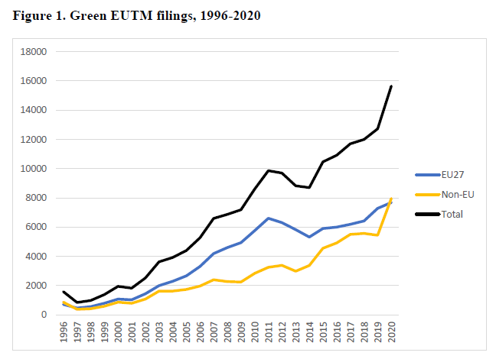
The exponential increase of EU eco marks since 1996
Trademarks: A vector for sustainable innovation and development
Illustrations
I
EUIPO – Green EU trade marks, analysis of goods and services specifications, 1996-2020 (study of Sept. 2021)

Slide 6
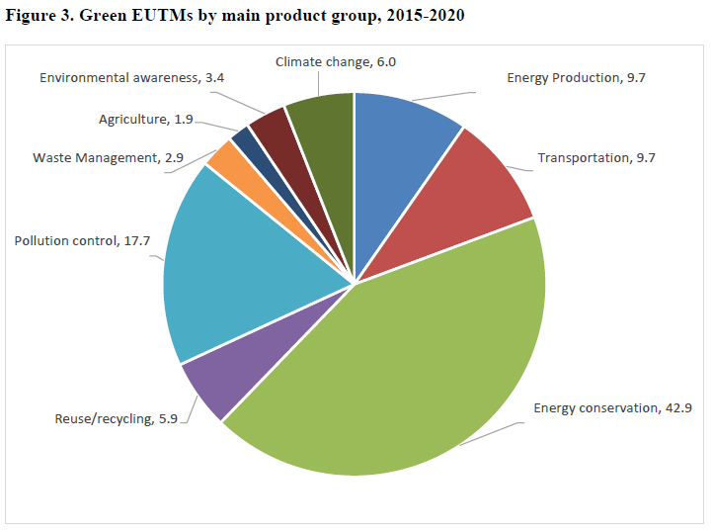
Energy Conservation and Pollution Control are the main product groups in relation to which most EU eco marks have been filed between 2015 and 2020
Trademarks: A vector for sustainable innovation and development
Illustrations
I
EUIPO – Green EU trade marks, analysis of goods and services specifications, 1996-2020 (study of Sept. 2021)
Notes:
The “Energy conservation” comprised, ‘storage of electricity’ (i.e. batteries of various kinds) was the most important sub-category. The second most important group was “Pollution control” was dominated by water purification products.

Slide 7
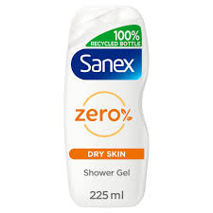
Green branding: examples of eco marks
Trademarks: A vector for sustainable innovation and development
Illustrations
I

Slide 8
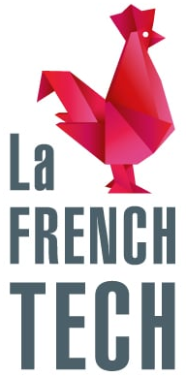
Examples of certification and collective marks
Trademarks: A vector for sustainable innovation and development
Illustrations
I

Slide 9
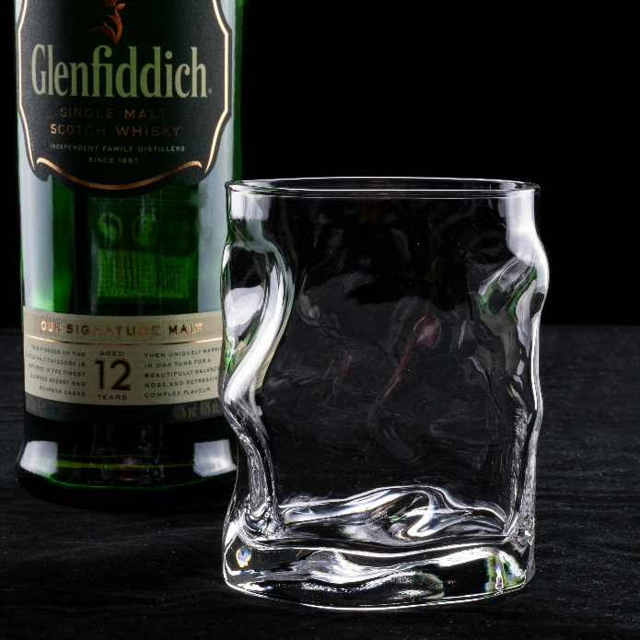
The limitations of trademarks
Its inherent deficiencies
(ii) The added value of other IP titles (i.e. Geographical indications)
I

Slide 10
European Commission – Sweep on greenwashing practices (January 2021)
Examination of 344 seemingly dubious claims out of which:
+50%: insufficient information provided to judge claims’ accuracy;
37%: included vague and general statements which conveyed the impression that the product had no negative impact on the environment (« conscious », « ecofriendly », « sustainable »)
59%: no easily accessible evidence were provided.
The limitations of trademarks
Its misuses
I
European Commission – Press Release “Screening of websites for greenwashing : half of green claim lack evidence” (28 January 2021)

Slide 11
By Ornella BISQUAY Avocate, Barreau de Paris Foreign Lawyer Mauritius Bar
Thank you for your attention!

