Slide 1
OVERVIEW
OF THE Industrial property FRAMEWORK
IN MAURITIUS

Slide 2



Slide 3
OUTLINE
Historical Background
Treaties
IP Framework and Legal Instrument
Recent Developments
IP Statistics
Collaboration with other institutions

Slide 4
HISTORICAL BACKGROUND
Mauritius - a long history of IP protection dating back to the colonial times.
2 legislations on Industrial property, namely
The Trade Marks Act 1868 and The Patents Act 1875
Copyright Act 1986 replaced by the Copyright Act 1997 and then by the Copyright Act 2014, as subsequently amended in 2017 (under the Ministry of Arts and Cultural Heritage)
Copyright and Related Rights are administered by the Mauritius Society of Authors (MASA),a collective management society established under the Copyright Act and which operates under the purview of the Ministry of Arts and Cultural Heritage
Industrial Property matters are handled by the Industrial Property Office of Mauritius which falls under the aegis of the Ministry of Foreign Affairs, Regional Integration and International Trade

Slide 5

TREATIES
MEMBERSHIP TO TREATIES ADMINISTERED BY WIPO/WTO/ARIPO
Mauritius is a Member State of the World Intellectual Property Organization (WIPO) through the Stockholm Act (1967) of the WIPO Convention
ARIPO through the Lusaka Agreement (September 2020)
The Paris Convention for the Protection of Industrial Property (24 September 1976)
The Berne Convention for the Protection of Artistic and Literary Works (10 May 1989)
the Trade Related aspects of the Intellectual Property Rights (TRIPS) April 1994.
Marrakesh VIP Treaty (11 April 2021)
Patent Cooperation Treaty (15 March 2023)
Madrid Protocol (06 May 2023)
Hague Agreement (06 May 2023)

Slide 6
EVOLUTION OF IP FRAMEWORK IN LINE WITH INTERNATIONAL STANDARDS
As part of the WTO requirement, Mauritius implemented provisions of the Trade Related Aspects of Intellectual Property Rights Agreement (TRIPS) in its legislations. A series of legislations were enacted to that effect in 2002, namely:
the Patents, Industrial Designs and Trade Marks Act (PIDT Act) 2002
the Protection Against Unfair Practices (Industrial Property Rights) Act 2002
the Geographical Indications Act 2002
the Layout Designs (Topographies) of Integrated Circuits Act 2002

Slide 7
The Industrial Property Act 2019
A modern framework
To update and strengthen Intellectual Property Protection, the previous legislation was repealed and replaced by The Industrial Property Act 2019 which is consolidated with objectives to:
cover all industrial property related issues in one Act, including patents, utility models, layout designs of integrated circuits, industrial designs, trademarks, geographical indication and plant varieties
reflect the dynamics of the changing IP environment and the use of IP as a tool
promote research, innovation and economic growth

Slide 8
The Industrial Property Act 2019 (Contd.)
The Industrial Property Act 2019 caters for the
restyling of the IP Office to Industrial Property Office of Mauritius (IPOM)
setting up of an Intellectual Property Council
filing of international applications for:
patents under The Patent Cooperation Treaty (PCT)
industrial designs under Hague Agreement
trademarks under The Madrid Protocol

Slide 9
Organizational Chart of the Industrial Property Office of Mauritius
DIRECTOR
TECHNICAL CADRE
1 PRINCIPAL INDUSTRIAL OFFICER
3 SENIOR INDUSTRIAL OFFIICERS
5 INDUSTRIAL OFFICERS
ADMINISTRATIVE CADRE
1 Confidential
Registry
Cashier

Slide 10

FORMATION OF INTELLECTUAL PROPERTY COUNCIL
Intellectual Property Council -an independent institution in Mauritius, looking at all the IP-related issues
Consisting of representatives from several departments, ministries, and private sectors involved in the generation, enforcement, and protection of IP assets and portfolio services
The Council shall advise the Minister on matters related to Intellectual Property and ensure coordination among the public and private sectors in the formulation of intellectual property policies, and enforcement of intellectual property rights

Slide 11
FILING OF APPLICATIONS UNDER INTERNATIONAL TREATIES
The Industrial Property Act 2019 consists of several measures, thus making the Mauritian Intellectual Property system more responsive to the needs of researchers, investors, and entrepreneurs.
These international systems facilitate the filing of patents, industrial designs and marks in multiple jurisdictions through a single application, thereby reducing the costs incurred
Accession to these Treaties has significantly increased the number of foreign applications for registration of industrial property rights in Mauritius.
(Note- a significant number of applications have been filed designating Mauritius under the Madrid Protocol)

Slide 12
IP Statistics 2020-2022
 | 2020 |  |  | 2021 |  |  | 2022
 | Resident | Non-Resident | Total | Resident | Non-Resident | Total | Resident | Non-Resident | Total
TRADEMARKS
No. of Applications | 1232 | 915 | 2147 | 1286 | 1088 | 2374 | 984 | 1136 | 2120
No. of Registrations | 997 | 997 | 1994 | 1176 | 1012 | 2188 | 1088 | 1123 | 2211
INDUSTRIAL DESIGNS
No. of Applications | 14 | 2 | 16 | 9 | 3 | 12 | 4 | 2 | 6
No. of Registrations | 18 | 4 | 22 | 8 | 1 | 9 | 3 | 4 | 7
PATENTS
No. of Applications | 6 | 19 | 25 | 6 | 14 | 20 | 0 | 8 | 8
No. of Grants | 1 | 16 | 17 | 0 | 4 | 4 | 0 | 1 | 1

Slide 13
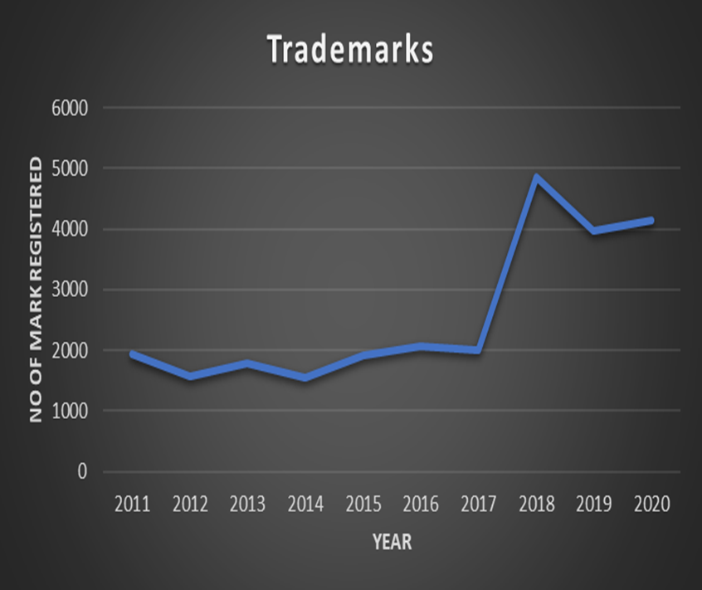
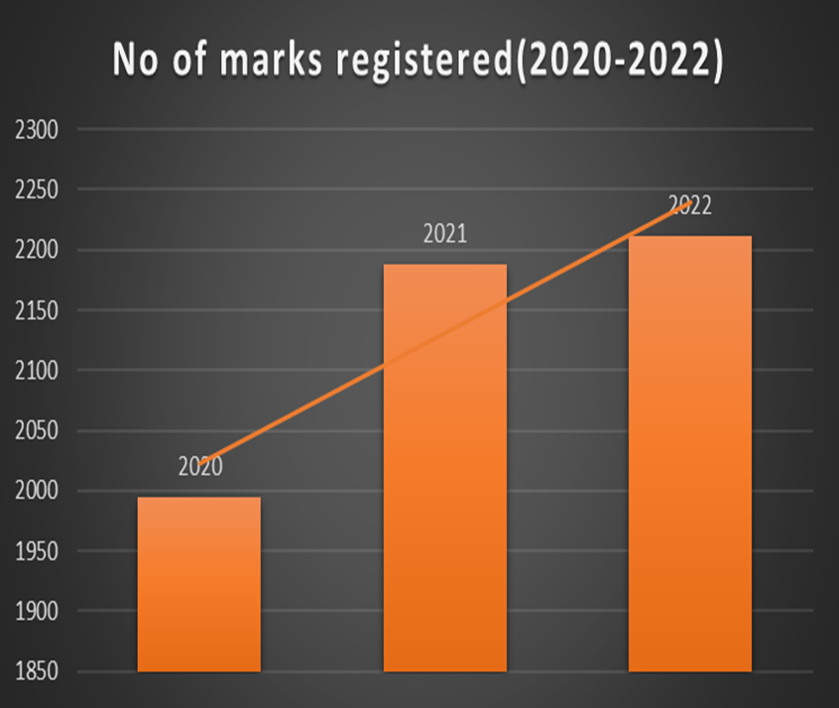
STATISTICS

Slide 14
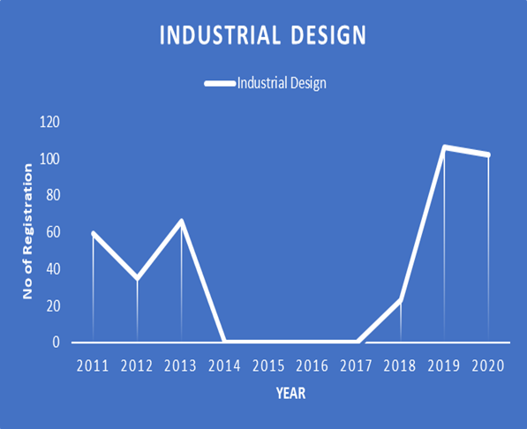
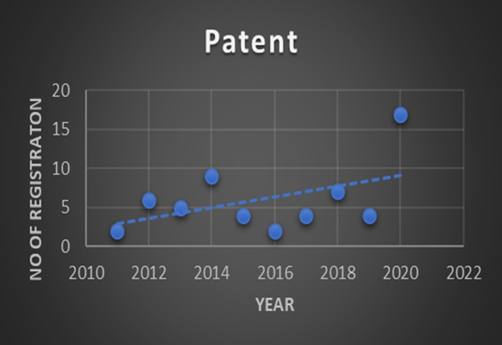
STATISTICS

Slide 15
KEY Mandates of ipom
The Industrial Property Office of Mauritius endeavors to support businesses and entrepreneurs involved in sustainable innovation by:
Conducting awareness campaigns and educational programs to inform stakeholders and the public in general about the importance of sustainable development and the role of intellectual property rights in fostering innovation.
Raising awareness among businesses, researchers, and the public about the benefits of integrating sustainability into their activities, as encouraged by the IP Act.
Collaborating with international partners and organizations to exchange knowledge and best practices in sustainable development and intellectual property rights.
Aligning Mauritius' efforts with global initiatives aimed at promoting sustainability and innovation, as outlined in the Act.
Facilitating the timely protection of IP rights.

Slide 16
COLLABORATION With other institutions
MRA Customs Department (Border Protection)
Police department (Infringement of Trademark-L’ADSU and Anti- Piracy Unit)
SLO (Legal consultation)
Partnership between the MRIC and the IP office
Other Ministries and Departments
SMES

Slide 17
MRIC and the IP office
The partnership between the MRIC and the IP office highlights the importance of collaboration between government agencies and research institutions. Such partnerships streamline administrative processes and increase awareness of IP rights among innovators, enhancing the effectiveness of policies and programs aimed at promoting innovation and sustainable development.
One great example is the fact that the MRIC has a scheme whereby it reimburses 50% of the costs incurred by an innovator to have his Industrial Design registered.

Slide 18
MRIC and the IP office
The partnership between the MRIC and the IP office highlights the importance of collaboration between government agencies and research institutions. Such partnerships streamline administrative processes and increase awareness of IP rights among innovators, enhancing the effectiveness of policies and programs aimed at promoting innovation and sustainable development.
One great example is the fact that the MRIC has a scheme whereby it reimburses 50% of the costs incurred by an innovator to have his Industrial Design registered.

Slide 19
Intellectual Property Promotion Scheme (IPPS)
A joint collaboration between the Mauritius Research and Innovation Council (MRIC) and the Industrial Property Office (IPOM)
The purpose of this scheme is to encourage individuals, enterprises, industry and R&D institutions to take advantage of the mechanisms for protecting innovation currently offered by the industrial property system in Mauritius. The IPPS aims to boost creativity and innovation, initially through support towards applications made for the grant of Patents and registration of Industrial Designs

Slide 20

MADHVEE BHURTUN NUCKECHEDDY

