Slide 1

Innovating for Social Change

Slide 2



Slide 3
Understand problems
Seek solutions
Decide and Act
Learn and Adapt
Notes:
Ayooshee

Slide 4
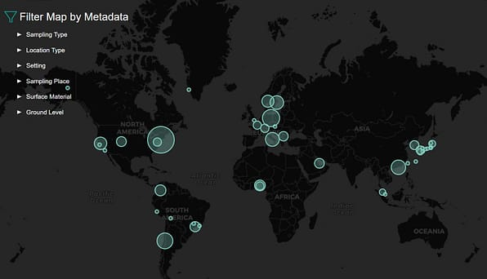
Source: metasub.org access 26 April 2022

Slide 5
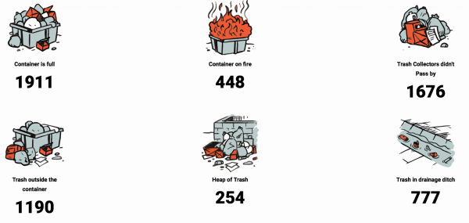
Source: https://www.makingallvoicescount.org/news/mopa-how-an-app-generates-data-that-help-clean-up-maputo/ accessed 26 April 2022

Slide 6

Open Innovation, Open Software, Open Data

Slide 7

Distributed Problem Solving

Slide 8

Novel Financing and Funding Models

Slide 9
Thank you!
Reach out: ayooshee.dookhee@undp.org

