Slide 1


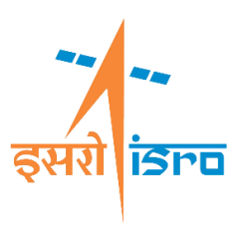
Space Technology: Key booster to R&D and Innovation
Government of India
Department of Space
LES ASSISES
de la Recherche
et de l’Innovation
Victor Joseph T
Associate Scientific Secretary, ISRO
Director, Technology Development & Innovation

Slide 2
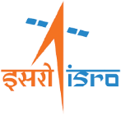
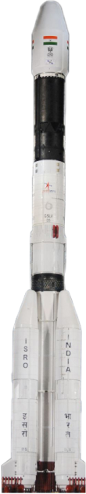
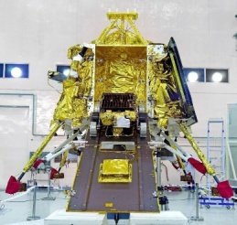
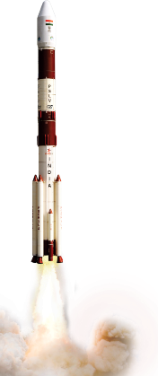
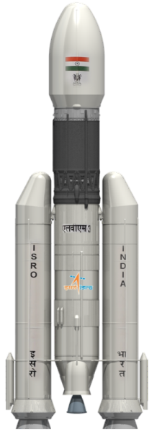
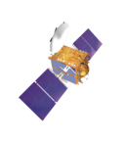

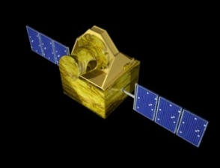
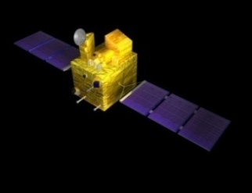
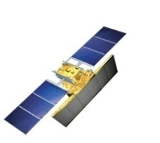
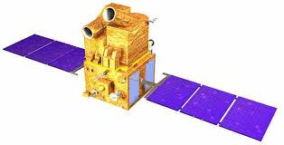
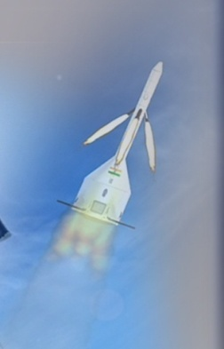
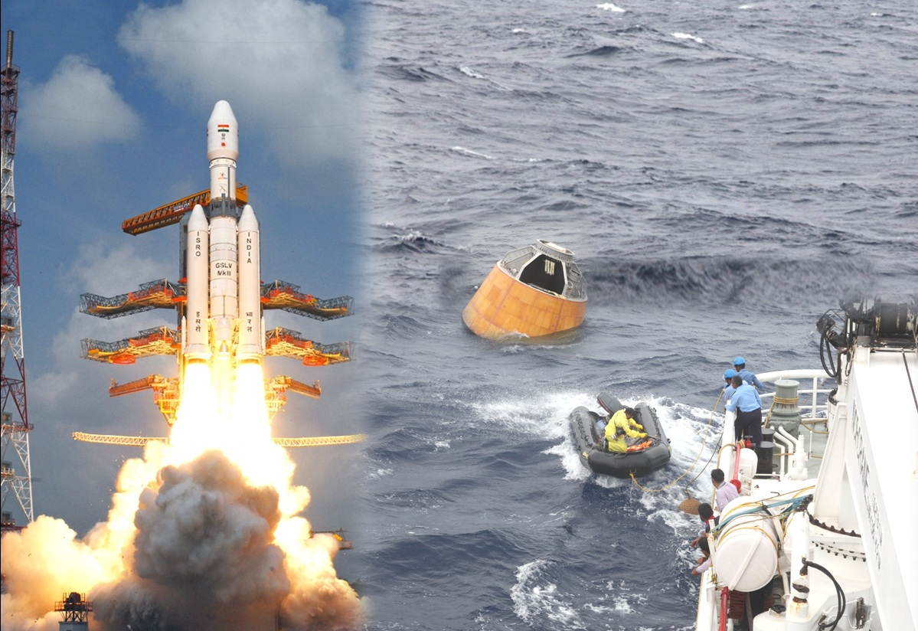
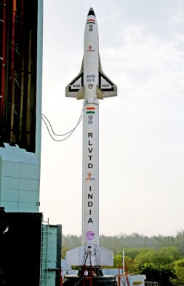
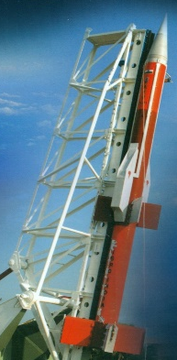
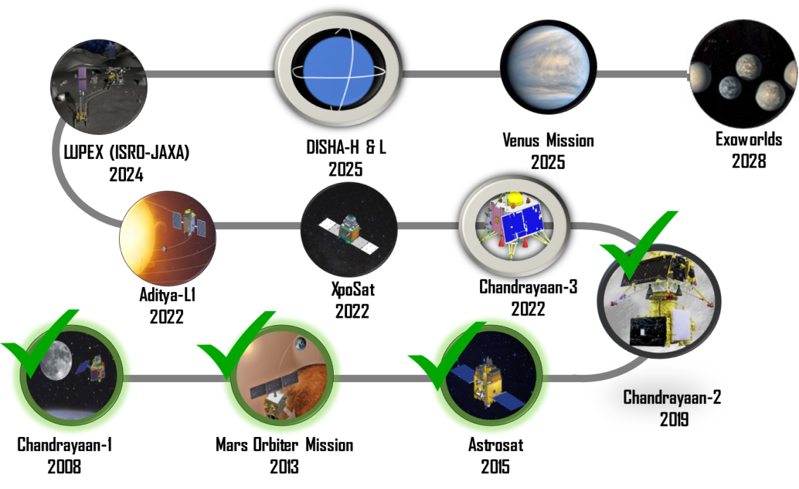
Indian Space Programme – at a glance
80
114
Remote Sensing
Communication
Navigation
SLV
ASLV
PSLV
GSLV
GSLV MkIII
199
Launch Vehicles
Satellite missions
Total
Missions
Technology Developments
Global Presence
5 Missions
342 Satellites
Pad Abort Test
For Crew Escape System Demonstration
Crew Module Atmospheric
Re-entry Experiment
Reusable Launch Vehicle-
Technology Demonstrator
34 countries
SCRAMJET
2 Re-entry
Mars Orbiter Mission
2013
Chandrayaan-2
2019
Chandrayaan-1
2008
Astrosat
2015
13 Student satellite missions

Slide 3



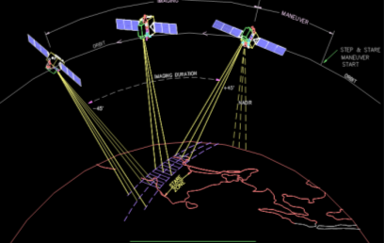
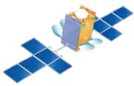

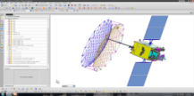
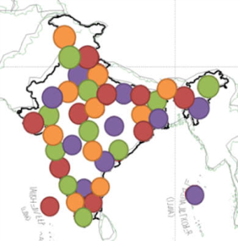
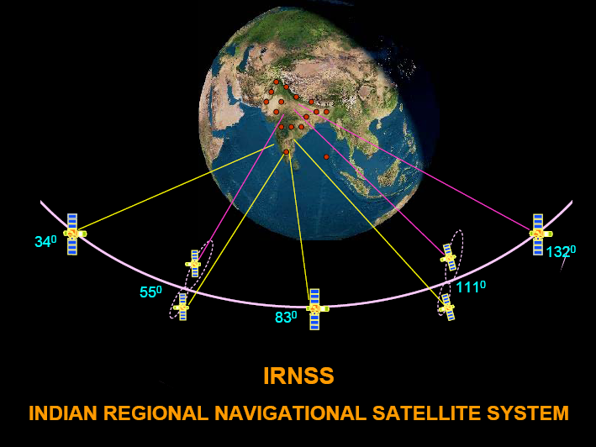
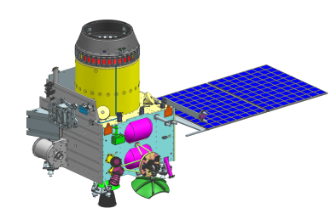
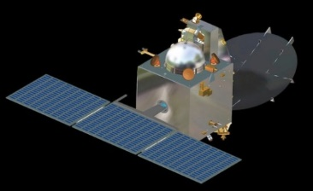
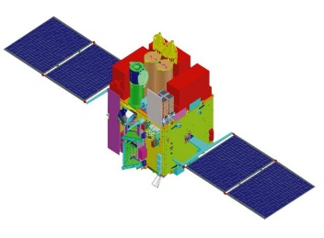
Space Infrastructure
High Throughput Satellites
DTH Satellites
Multibeam S-band
17
21
Communication
Earth Observation
08
Lunar Exploration: Chandrayaan-2
  Planetary Exploration: Mars Orbiter Mission
03
  Space Astronomy: ASTROSAT
Navigation
Space science

Slide 4
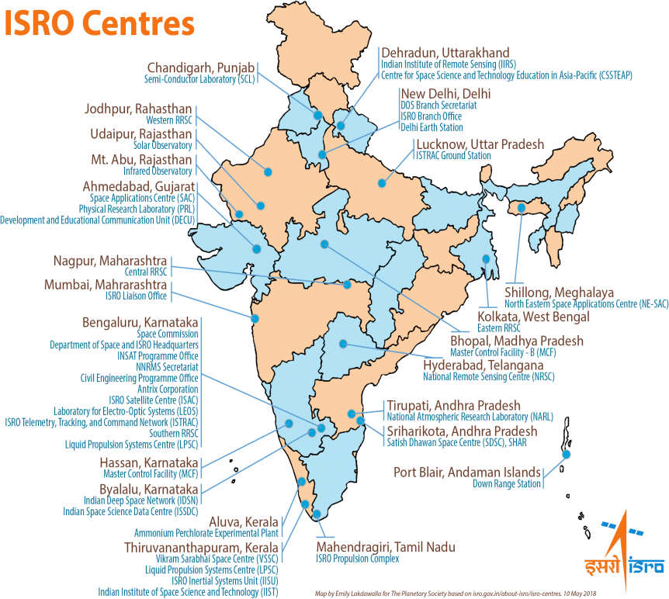














ISRO-Academia-Industry Interface & Capacity Building
Space Eco System
CURRENT INDIAN SCENARIO
5
450+
Regional Academic Centre for Spaces
6
Small / Medium Industries
50+
Space Technology Incubation Centres
Large Industries
9
55+
Space Technology Cells
Start-ups
Launch Vehicle Building
Satellite building
Space Application
300
Sponsored Research
ISRO & its Technical Ecosystem
Academics
Industries & Startups
17,000
13,000 Technical
Fostering Innovation in Academics
Growing Industry Base
Glimpse of start-ups in India across Space
National Collaborations
Launch Vehicles
Satellites
Data Application

Slide 5

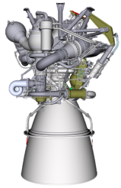
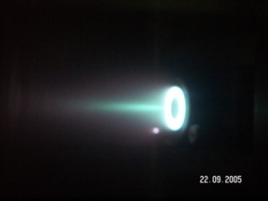
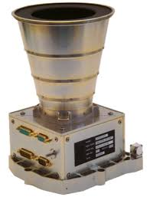
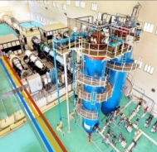

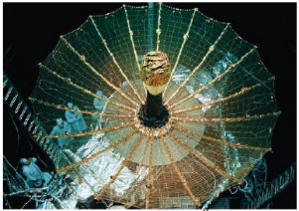
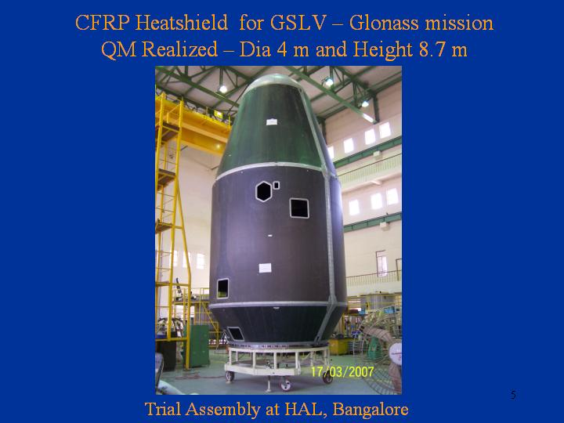
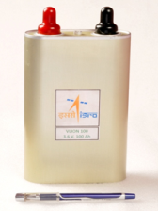

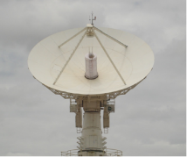
ISRO Centers
Multidisciplinary domain expertise in ISRO: R&D & Innovation
Launch Vehicle
Satellites
Propulsion technology
Propulsion technology
Aerodynamics, Mission design & Simulation
Optical, Microwave, scientific & communication Payloads
Avionics & Control Systems
Deployable structures, Bus Systems
Structural design, Materials, Composites & Fabrication
Power systems & Thermal management
Chemicals &
Pyro systems
Communication systems & Ground Infrastructure
System engineering, Integration & Product development

Slide 6

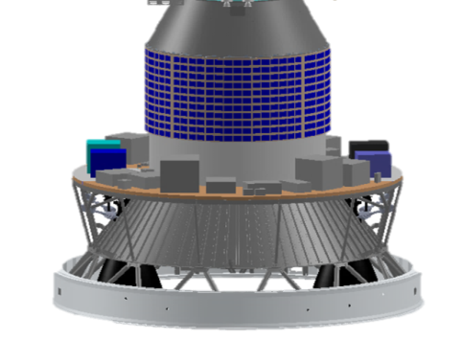
Experimental platform: Opportunities for R&D
PSLV upper Stage as Orbital Platform
  Boon for scientific and student community; availability of high cost platform at no extra cost
  Low cost platform for short duration
  (1-6 month) experiments
  Power & telemetry with standard interfaces & reserved bandwidth
  Different orbits using PS4 engine Restart capability
  3-axis stabilized micro gravity environment
Experiments:
Studies for Human Spaceflight
Quantum technology
Plant growth
Robotic arm
3D printing in space
Rendezvous & Docking
Thermospheric study Instruments
  Airglow
  Thermal sensor
Experiments by private: Announcement of opportunities
PSLV Orbital Platform
Next – PSLV C53 June 2022

Slide 7
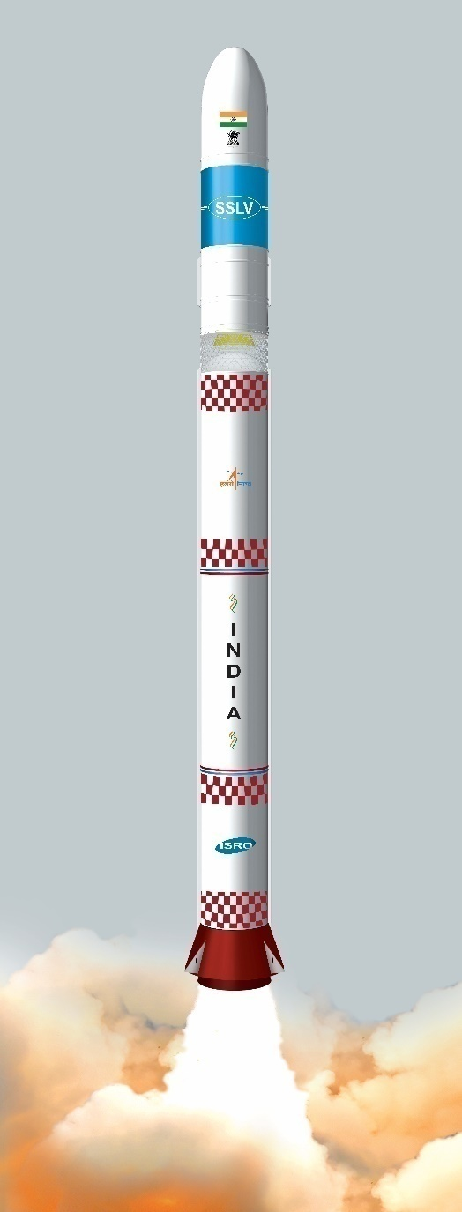
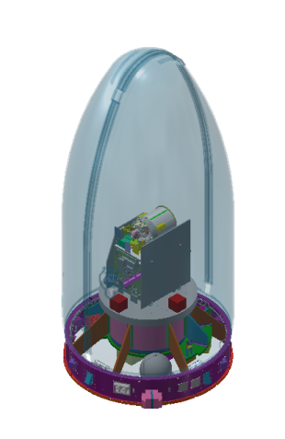
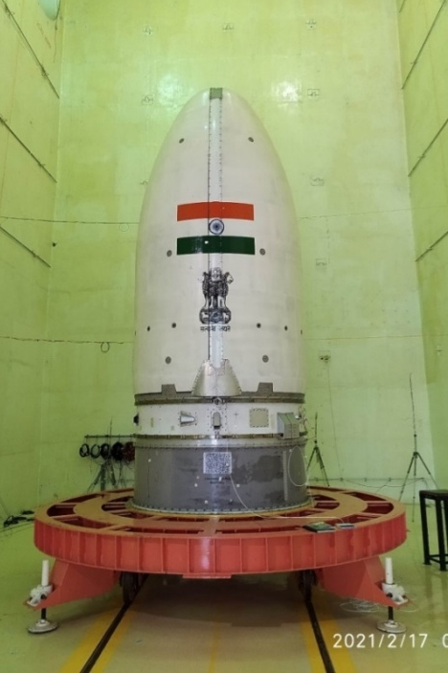
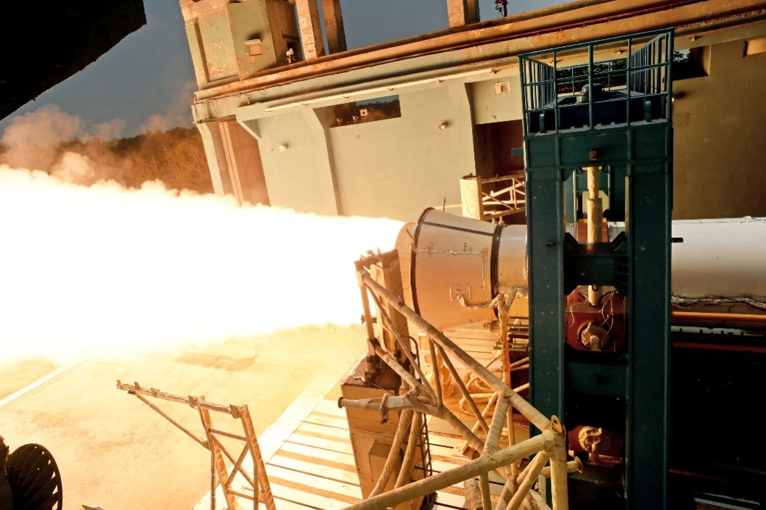

Small Satellite Launch Vehicle development
…for emerging requirement of launching small satellites
Features
Global trend
    Cost effective Launch Vehicle
    On demand launch capability
    Minimum launch-pad occupancy
    Production friendly
    Increasing demand for small satellite constellations
    58% demand by 5 mega constellations
    ~1500 satellites launch per year from 2030
2m Ø
34m long
  4 Stages
  120T Lift off mass
500 kg payload to LEO
Glimpse of Hardware Testing

Slide 8
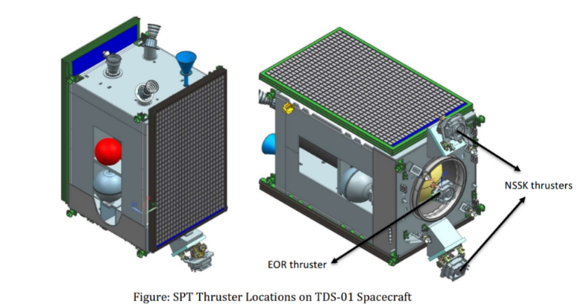
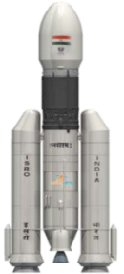
Future Launch Vehicles & Satellites under development
Advanced Satellites
High throughput & performance
Satellite constellations
Deep space navigation systems
Advanced sensors
Payloads to carry out earth observation & space science
All electric propulsion spacecraft – TDS-01
Higher Isp (2000s vs 320s in Chemical Propulsion): Reduced launch cost/Increased payload
5.5T class CPS satellite
3.5T class EPS Satellites
Reducing Payload mass
6 T class
Advanced launch Vehicles
Semicryogenic stage
Technology updates to improve reliability and cost
Recovery & Reusability
Improving the payload capability

Slide 9
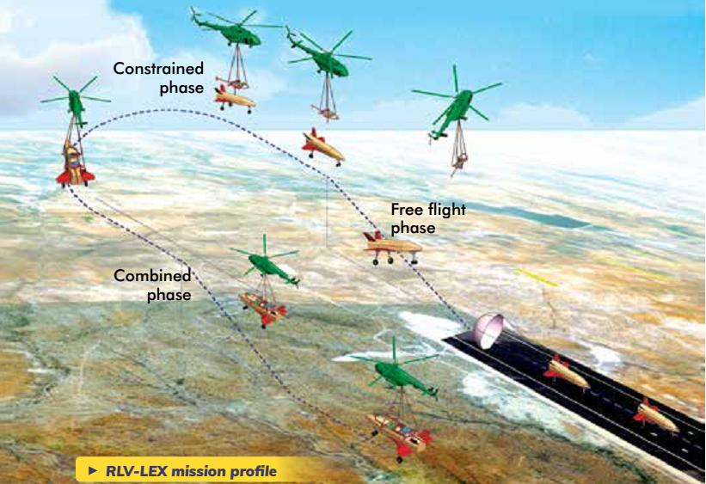
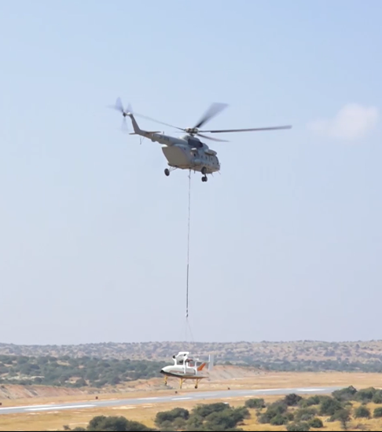
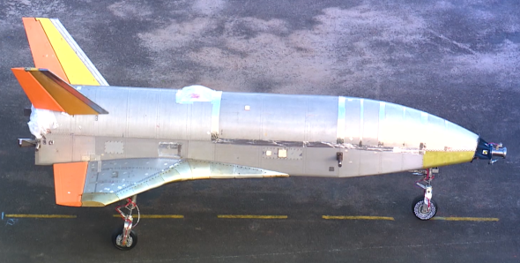
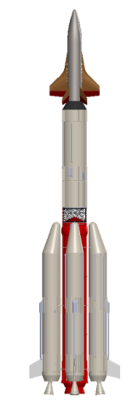
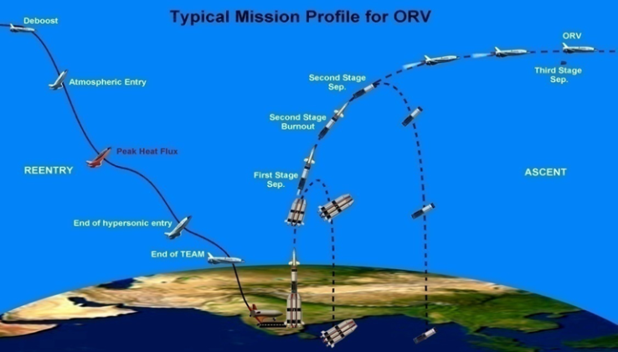
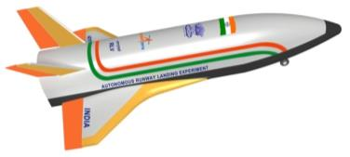
Reusable Launch Vehicle
Landing Experiment
Planned in a Defence air field near Chitradurga, Karnataka
RLV will glide, navigate towards the runway & lands autonomously with a landing gear
Altitude : 3 km
RLV Orbital Re-entry Experiment (ORE)
RLV will ascent to orbit, stay in orbit, re-enter and land on a runway like an aeroplane

Slide 10
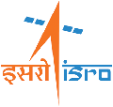
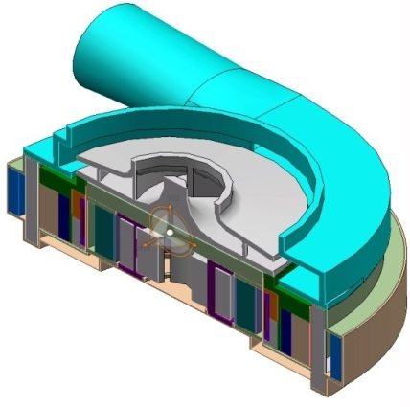
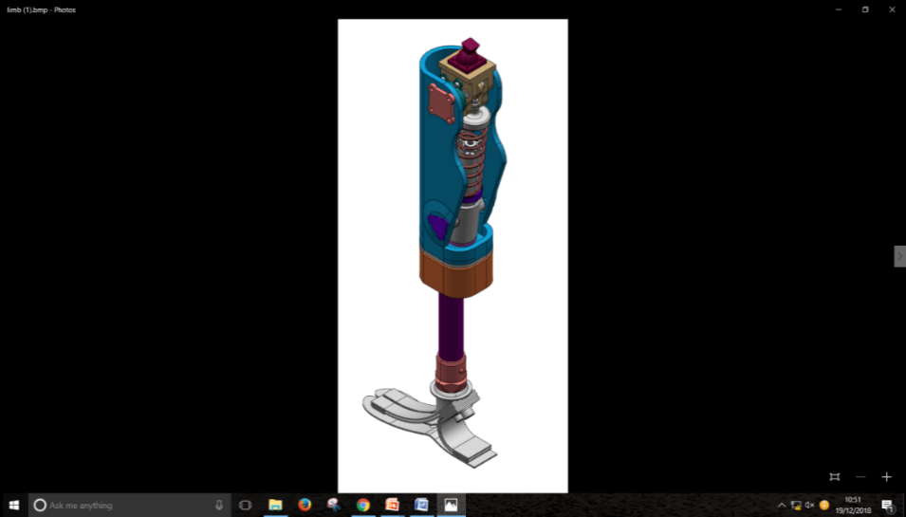
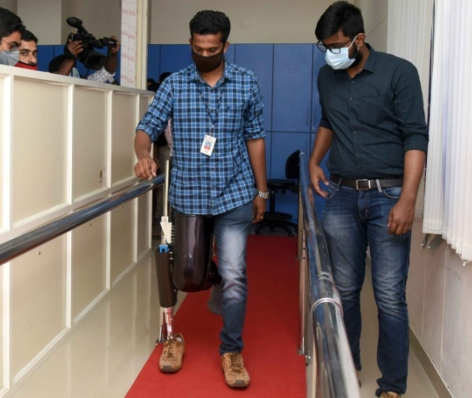



Recent technology spinoffs for medical application
1. Ventricular Assist Device
2. Microprocessor controlled Limb
CFD | Turbopump design | Magnetic Levitation
Dampers | Control electronics | Composites
3. Medical Ventilators
Control systems | Precision fabrication | Actuators

Slide 11


Space Technology Applications
Water Resources Assessment
Potential Fishing Zones
Renewable energy
Weather, Agromet & Forest
Tele-medicine and Tele-education
Air Quality Monitoring
NavIC services
500+ industry Partners & Start-ups
Technology transfer
Telecommunication & Broadcasting
Capacity Building in Industry
Job Creation
Infrastructure Development Support
Societal
Economy
Disaster
Management
Governance
Flood, Cyclone, Landslide, forest fire, Drought
Multi-Scale National Database
Early Warning System
Hazard Assessment & Zonation
Near Real Time Monitoring & Damage Assessment
Irrigation Infrastructure
Rural Employment
Housing Schemes
Rural Roads
Decentralized Planning

Slide 12



Space market & demand
Upstream
Satellite Manufacturing & Launch
Technology Push
Space Market
Midstream
Operations: Satellite & Ground infrastructure
Demand Pull
Downstream
Applications: EO, Communication, Data services, Data Analytics
2%
$2.8Bn
$5.9Bn
$360Bn
$9.7Bn
Statistics as on 2022

Slide 13






New Space Era – Global trends
Next generation satellite systems
Manufacturing in Space
Small satellite constellations
Space based solutions: IoT; Automation & Governance
Space tourism
Space Traffic Management

Slide 14


Space Economy Forecast: 2047
ISRO: Technology enabler
Industry: Lead and implement
2047
Target : 50% global space economy
50%
2035
India – Global Space manufacturing hub
30%
~$1.5tn
Global space investments
Sector in 2020 ($Bn)
Commercial Space travel
$800 bn
Space Manufacturing
Ground equipment
2025
10%
Satellite & Launch vehicles
Focus on emerging second order impacts
Satellite Data Industry
~$0.75tn
$500 bn
Second Order Impacts
2%
Broadband services
Present
Non-Satellite Industry
$360bn
Targeted Indian Share in Global space economy

Slide 15


Smart Transportation
Intel’s estimate:
1 Autonomous Car consumes data of approx.
2666 internet users
Data need for connected transport
Vehicle to vehicle
In-vehicle
Vehicle to infrastructure
Vehicle to grid
Automated traffic management
Automated surveillance

Slide 16



Satellite Applications in SMART CITY
Manage critical energy infrastructure
Integration of satellite telecommunication and EO technologies
Structure monitoring
Temperature monitoring
Location & Navigation
Mixture of communication platforms
M2M opportunities
M2M opportunities

Slide 17




Smart Manufacturing & Supply chain
Traditional manufacturing – Highly mechanized
Mass Manufacturing
Automated Manufacturing
Smart Manufacturing
Smart Supply Chain
Source: Deloitte analysis

Slide 18









Zero Government, Maximum Governance
IT & Space Integration
Global trends
Business intelligence in Every walk of life
Data as a service – on demand access to information
Big data analysis in decision making
Human machine symbiosis
Data collection
Processing
AI engine
Geospatial network
Surveillance data
Communication network
Indian Scenario
Transparent & De-centralized governance
India’s Strength:
+
+
Digital solutions for Technology enabled Governance
Flourishing Software industry
Self-reliant Space Industry
INTERNET PENETRATION

Slide 19

Space Technology
Shaping Young Minds
Capacity Building in Civilian Space
Synergising nations resources
Thank you….

