Slide 1
Les Assises de la Recherche et de l'Innovation
2
+
Blue and Green Innovation
Barriers and Improvement
28 April 2022
https://globe-net.com/green-economy/

Slide 2
Gaps and barriers in Blue sector
2
+
2
+

Slide 3
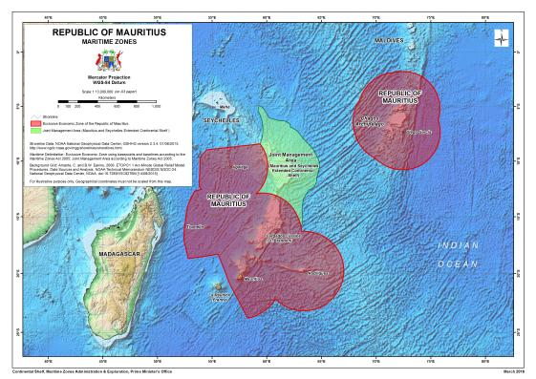
Mauritius consists of an exclusive economic zone of an area of 2.3 million km² that includes 400 000 km² jointly managed with the Seychelles
Mauritius has thus a huge maritime zone with potential of exploiting the waters, seabed and subsoil

Slide 4
GAps and barriers in Blue sector
1
Inadequate enforcement of laws: high cost of carrying out surveillance missions at sea
2
Absence of a national plan to explore the blue sector
3
4
Limited database on maritime resources
Sparse knowledge for full exploitation of our marine resources
5
Inadequate adoption of emerging technologies

Slide 5
Gaps and Barriers in Blue sector
7
Limited incentives, business advantages to attract investments in maritime industries, that are capital intensive
Limited value added products from marine resources
6
9
Limited R&D and innovation in the sector, including protection of the marine environment, effect of climate change
8
Insufficient inventories, databases of our local marine resources

Slide 6
Gaps and barriers in GREEN sector
2
+
2
+

Slide 7
GAps and barriers in green sector
1
2
Insufficient incentives to support local production of seed and planting material
Limited incentives to promote research at farm level
3
4
Limited access to innovative technologies and adequate resources not available for adoption of new technologies
Inadequate capacity building to develop a modern skilled workforce and technical expertise for emerging sectors
5
6
Limited information available on soil health: soil mapping and microbial flora
Reluctance to adopt emerging technologies

Slide 8
GAps and barriers in GREEN sector
7
8
Labour shortage/ ageing labour force/brain drain
High cost of production
10
9
Little adoption of biotechnology tools
Insufficient infrastructural development to enhance agricultural research & innovation
12
Substantial investment required to take a project beyond proof-of-concept stage and start a business
11
13
Competition for land from other sectors which are more remunerative
Difficult for local produce to reach global market

Slide 9
Improvement in Blue sector
2
+
2
+

Slide 10
Improvement in blue sector
Enhance aquaculture and fisheries development
Acquisition of oceanographic data
Modelling of coastal and oceanic processes
Exploration and mapping of resources in the nearshore and oceanic waters
Address global issues - climate change, coastal erosion, marine pollution, maintain marine ecosystems
Monitoring: control and surveillance to fight illegal unreported and unregulated fishing
Implement projects in emerging sectors (biotechnology and renewable energy, biodiversity, AI): attract investors
Promote R&D
Develop a circular economy (eliminate waste, circulate materials, regenerate nature)

Slide 11
Improvement in blue sector
Continental Shelf, Maritime Zones Administration and Exploration
New legal and regulatory framework required to enable sustainable exploration of seabed minerals
Need for an Ocean Observatory E-platform – A platform to collect, store, organise and provide access to spatio-temporal data relevant to ocean exploration and development

Slide 12
Improvement in Green sector
2
+
2
+

Slide 13
Improvement in GREEN sector
Enhance crop productivity and quality food through development of new crop varieties, good quality seed and planting material, improve disease and pest controls
Modernize farming (integrate mechanization/AI technologies): labour issue
Enhance sustainable agro-ecological farming practices, sheltered farming, hydroponics
Invest in modern high rise glass houses: attract investors
Invest in R&D in the agricultural sector, including livestock

Slide 14
Improvement in GREEN sector
Engage in new research fields:
Molecular breeding, genetics
Applications of AI, robotics in agriculture
New agronomy practices
Biotechnology
Biosecurity
Climate change
Food processing, packaging
Medicinal plants

Slide 15
Improvement in GREEN sector
Adopt smart agriculture with the aim to modify agricultural practices (less inputs)
Promote organic food production
Engage in a circular green economy

Slide 16
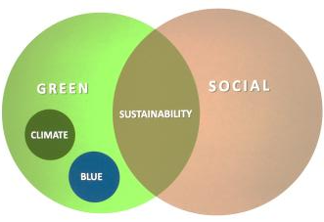
Improvement in GREEN sector
Bank of Mauritius (BoM)
In the 2020/2021 Budget, the Minister of Finance, Economic Planning and Development announced that BoM would come up with a framework for Blue and Green bonds
June 2021, BoM issued a guide for sustainable bonds in Mauritius
Sustainable Bonds constitute financial instruments aimed at supporting sustainable development by raising capital to finance or re-finance Green or Social or Sustainability-linked projects

Slide 17
THANK YOU
2
+
2
+

