Slide 1
LET THERE BE LIGHT

Slide 2
Sydney Pierre
Chief Sales & Marketing Officer
Marriott Mauritius

Slide 4
DO YOU KNOW?

Slide 7
WHAT IF?

Slide 8
5%?

Slide 9
10%??

Slide 10
15%???

Slide 11
20%!

Slide 12
INTRODUCING…

Slide 13
INTRODUCING…

Slide 14
INTRODUCING…

Slide 15
GRMS
Guest Room Management System

Slide 16
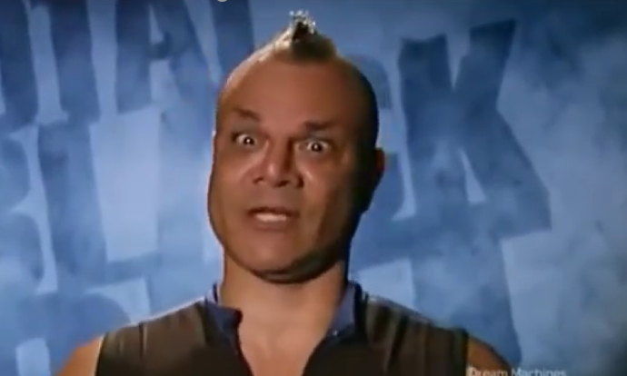
THANK YOU

