Slide 1
An early warning system for disaster management using mass calling and SMS technology
University of Mauritius (UoM) / National Disaster Risk Reduction and Management Centre (NDRRMC)

Slide 2


Team Members
Presentation of Team Members:
Mr Raj Moloo
Assoc Prof Kavi Khedo
Mr Aatish Chiniah
Mr Runden Monique
Mr Nayar Joolfoo
Department of Digital Technologies,
Faculty of Information Communication & Digital Technologies (FoICDT),
University of Mauritius

Slide 3
Agenda
Introduction
Main Features of System
How it works ?
Demo
Live Testing
Findings
Recommendations

Slide 4
Introduction
Developed in collaboration with the National Disaster Risk Reduction and Management Centre (NDRMMC) and sponsored by the MRC
Provides a simple and effective technology solution using mass voice call to prepare and warn vulnerable population group well in advance in case of disasters, hence minimizing casualties.
It is accessible to everyone through mere phone calls without the need of higher end phones and internet connectivity.
Within minutes it can be deployed to mass call/ SMS a particular vulnerable group through its user friendly web interface. .

Slide 5
Why Call ?
Immediacy in emergency situations – msg should effectively reach audience
  – Our findings show that around 94% of the callees answered their phones immediately suggesting the reachout of our system compared to others.
SMS/ Smart app notifications are passive – users might not read them
Everyone has a mobile phone – easier to reach them as compared to other traditional media

Slide 6
Main Features of the System
Ubiquitous –When people are on the move they can be reached anywhere and at any time via their GSM phone as compared to other traditional media
Call/SMS campaigns can be easily created and deployed without being a telephony expert
Push & Pull Based Information Delivery Service
Cater for different types of Users
  Registered – those who want to be informed on latest status of crisis
  Non-Registered/ Ad-hoc users – targeted/ vulnerable groups
Call Campaigns Tracking/Reports – Monitor calls and effectiveness of campaigns
If disaster is localized, can reach out specific target groups through their mobile phones in real-time. Hence limiting casualties

Slide 7


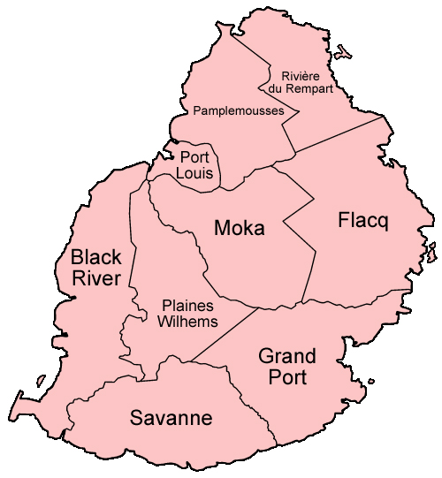
How it works ? - Push Based Information Delivery Service
3
Admin creates Campaign
1
Registered Users
4
2
Call all phones in Region
List of Users from Telephony Operators

Slide 8


How it works ? - Pull Based Information Delivery Service - IVR
Calls System
Plays Cyclone Warning file
1
2
3
IVR Menu:
Press
Cyclone Warning
Precautions
Refugee Centers
Plays Precaution file
User
4
5
Plays Refugee Center
file

Slide 9
Demo
3 Case Scenarios
Torrential Rain Alert (Push Based)
Torrential Rain Alert( Pull Based/ IVR)
SMS Alerts

Slide 10
Methodology
Research on existing early warning systems for disaster managementt , technology used and their effectiveness
The design and implementation of an early warning system for disaster management using mass calling and SMS
Live Testing on target groups
Survey of target groups (face to face/ phone interviews)
Call Analytics on system
Statistical Analysis of Data
Recommendations

Slide 11
Live testing - Target groups
Target Groups | # | Target Groups | #
NDRRMC |  | FiTEC
NDRRMC members | 18 | 8. Mauritian Fishermen | 46
NEOC |  | 9. Agalega Fishermen | 40
2. NEOC members | 43
CDRT |  | FAREI Planters
3. Bel-Ombre | 10 | 10. Mapou | 40
4. Poste De Flacq | 30 | 11. Plaisance | 17
5. Canal Dayot | 26 | 12. Unity | 16
6. Fond Du Sac | 11 | 13. Palma | 40
UNIVERSITY OF MAURITIUS |  | 14. St-Pierre | 36
7. Year 2 and Year 3 Students | 146

Slide 12
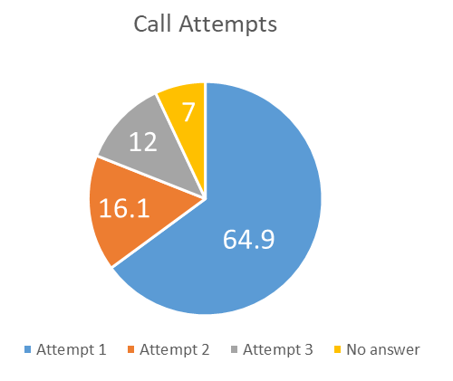
Live testing – Call Analytics (1)
No of calls performed = 733
~ 94% answered the alert call almost immediately –
the majority listened to the alert message in full (78%) .*
Denotes immediacy of message delivery as compared to SMS/ Notifications

Slide 13
Live Testing – Surveyed population
Target Groups | #
CDRT | 35
Planters | 48
Fishermen | 16
University Students | 112
TOTAL | 211
Mix of both Face to Face and Telephone interviews

Slide 14
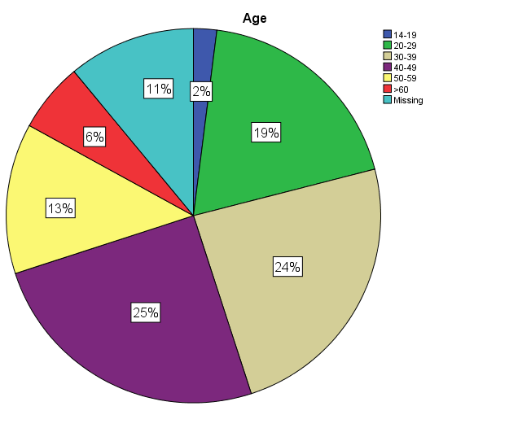
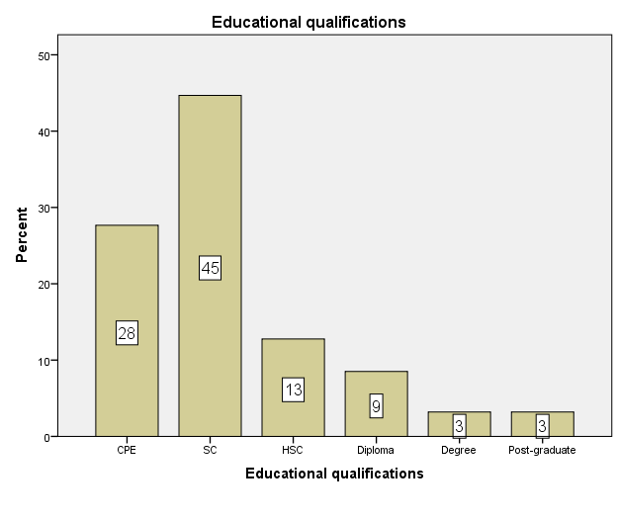
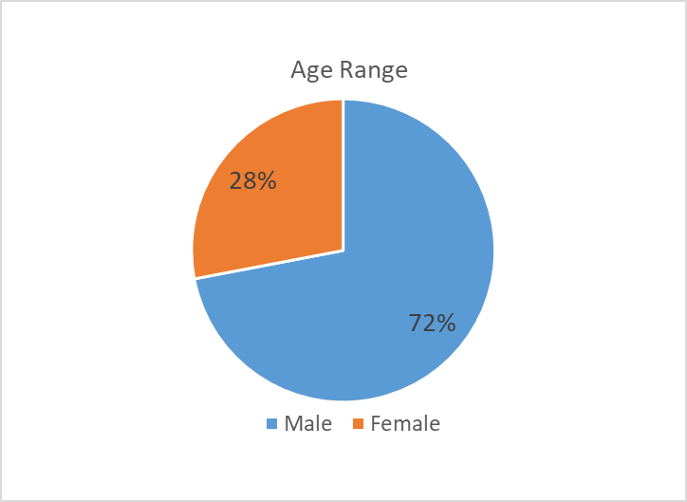
Findings - Demographic Attributes

Slide 15
Survey Response (1)
Questions | Response | %
Useful Alert Message | Agree | 90.8%
Easy Alert Message | Agree | 85.7%
Listen to whole message | Agree | 86.7%
Message Duration OK | Disagree | 58.2%
Good sound quality | Agree | 85.6%
Recommend it to others | Agree | 96.9%
Subscribe to alert service | Agree | 98.0%
Callblast system easy | Agree | 99.0%
Callblast system effective | Agree | 99.0%
Inform their contacts immediately after the call | Agree | 88.0%

Slide 16
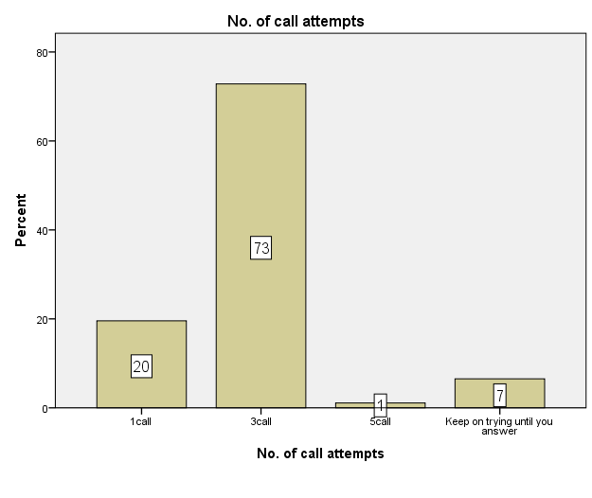
Survey Response (2) – Ideal no. of Call Attempts

Slide 17
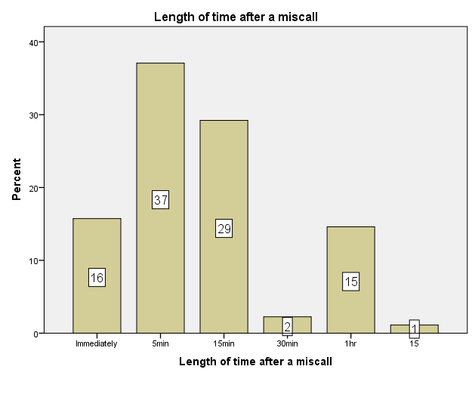
Survey Response (3) – Wait time before a retry

Slide 18
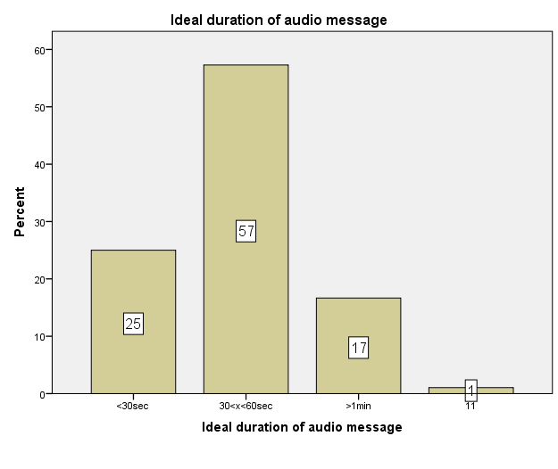
Survey Response (4) – Ideal Message Duration
Bet 30s to 60s
BUT !
But it should contain all the
Necessary information

Slide 19
Survey Response (5) – Alert Message Preference

Slide 20
Recommendations (1)
Alert calls should have ALERT label as caller identification.
It is recommended to have a pull-based service as well (i.e, a callback feature, whereby users can call back the same number which called them and listen to the Alert message) in case they could not answer the phone, as confirmed in the survey results.
Three (3) calls attempts is enough to warn users accompanied by the pull-based service + SMS.
A 5 min interval after the first miscall attempt and a 15-minute interval after the 2nd miscall attempt is advisable.
Alert messages played should be within 30s-60s to captivate the attention of users.

Slide 21
Recommendations (2)
6. Send SMS as well in addition to the Alert call, just in case they missed the call
7. It is recommended to integrate the system directly to gateways of telephony operators to leverage their existing infrastructure allowing maximum simultaneous calls.
8. It is advisable that calls are made in phased mode so as not to congest/ flood the bandwidth, Eg. A batch of 1000 at a time.
9. NDRMMC to have MoUs with major telephony companies to easily and quickly send a list of mobile phone users in a particular affected area so that these groups can be reached via their phones for the early warning message.

Slide 22
Other Applications
In Agriculture
In Fisheries
In Heath sector
In Education
& others

Slide 23
Thank You

Slide 24
System Architecture

